Slide 1
The Emergence of the Global Fintech Market: Economic and Technological Determinants
Christian Haddad
EDHEC Business School, France
Lars Hornuf
University of Bremen, Germany

Slide 2
Outline
Introduction
Motivation
Research question
Hypotheses
Data and method
Summary statistics
Empirical results
Policy implication
Conclusion

Slide 3
introduction
It is defined as a process whereby a smaller company with fewer resources is able to successfully challenge established incumbent businesses (Christensen, Raynor, and McDonald, 2015).
Amazon’s evolutionary disruption of the publishing industry, to Uber’s emergence distrupting the taxi industry, to Airbnb upsetting the hotel industry (Zachariadis and Ozcan, 2017).
ATMs enabled the explosive growth of retail finance during the last decades of the 20th century and Online banking (1999)
Fintech has revolutionized the financial industry by changing the way consumers interact with banks
Notes:
Technology in general has an established and long history of ﬂashes of disruption and is as inﬁnite as ingenuity with a multitude of examples ranging across many facets of business and social life

Slide 4
motivation
Crowdlending :
Scholars have analyzed :
The geography of investor behavior (Lin and Viswanathan, 2015)
The likelihood of loan defaults (Serrano-Cinca et al.,2015; Iyer et al.,2016)
Investors privacy preferences when making an investment decision (Burtch et al.,2016)
Equity crowdfunding & reward-based crowdfunding :
Researchers have investigated:
The dynamics of success and failure among crowdfunded ventures (Mollick, 2014)
The determinants of funding success (Ahlers et al., 2015; Vulkan et al., 2016)
The regulation of equity crowdfunding (Hornuf and Schwienbacher, 2016)
Risk and regulatory : Bohme et al., 2015; Gandal and Halaburda, 2016
Social trading platforms : Doering et al., 2015
Robo-advisors : Fein, 2015
Mobile payment and e-wallet services : Mjolsnes and Rong, 2003; Mallat et al., 2004, Mallat, 2007

Slide 5
motivation
Global European crowdfunding market : Dushnisky et al. (2016)
Provide a comprehensive overview of the European market
Conclude that legal and cultural traits affect crowdfunding platform formation
Global venture capitalist investments : Cumming and Schwienbacher (2016)
Examine venture capitalist investments in fintech startups around the world
Attribute venture capital deals in the fintech sector to the differential enforcement of financial institution rules among startups versus large established financial institutions after the financial crisis

Slide 6
Research question
Why do some countries have more Fintech startups than others ?

Slide 7
Hypotheses
Fintech startup formations
Demand for fintech startups (Thornton, 1999; Choi and Phan, 2006)
Well developed financial markets
Availability of latest technologies
More fragile financial sector
Supply for entrepreneurship in the fintech market (Choi and Phan, 2006)
Flexible labor regulations and larger labor market

Slide 8
Hypotheses
H1: Fintech startups formations occur more frequently in countries with well-developed economies and capital markets
Access to capital is more available in well-developed economies
Larger capital market offers greater opportunities to distrupt established financial institutitions
H2: Fintech startups formations occur more frequently in countries where the latest technology and supporting infrastructure are readily available
Technological advancements are among the most important drivers of entrepreneurship
Mobile and smartphone usage accelerated the change through digitalization

Slide 9
Hypotheses
H3: Fintech startup formations occur more frequently in countries with a more fragile financial sector
Lack of trust in the banking sector
The increased cost of debt to small firms
The strict regulation that applies on banks
H4: Fintech startups are more frequent in countries with a more benevolent and a larger labor market
Flexible labor market regulation
Large labor force

Slide 10
Data and Method
CrunchBase database (Bernstein et al.,2016; Cumming et al.,2016).
7,353 fintech startups.
Period studied 2005 – 2015 covering 107 countries
We categorize nine types of startups (EY, 2016; WEF, 2017) :
Asset management
Exchange services
Financing
Insurance
Loyalty program
Others
Payment
Regulatory technology
Risk management

Slide 11
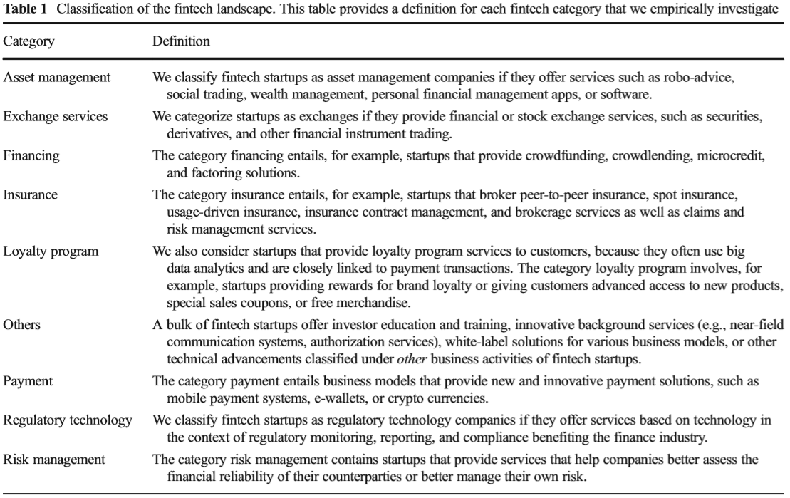
Data and Method

Slide 12
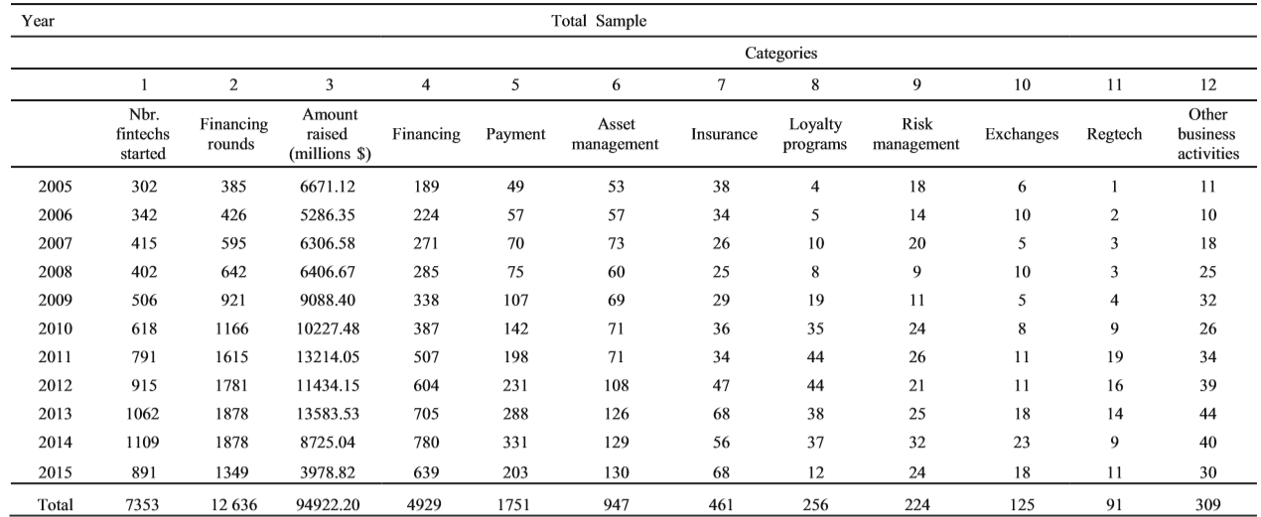
Summary Statistics

Slide 13
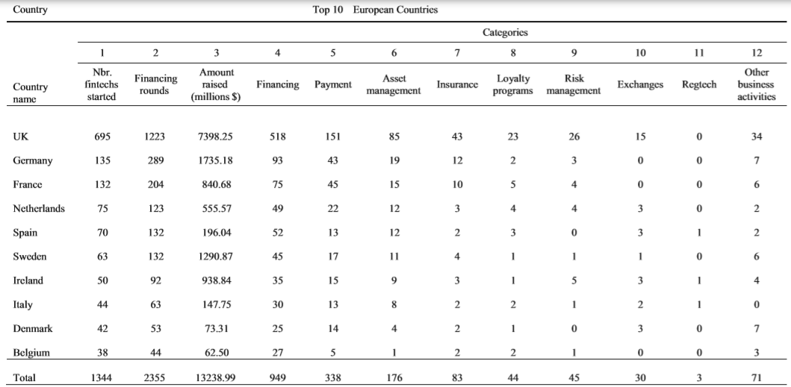
Summary Statistics

Slide 14
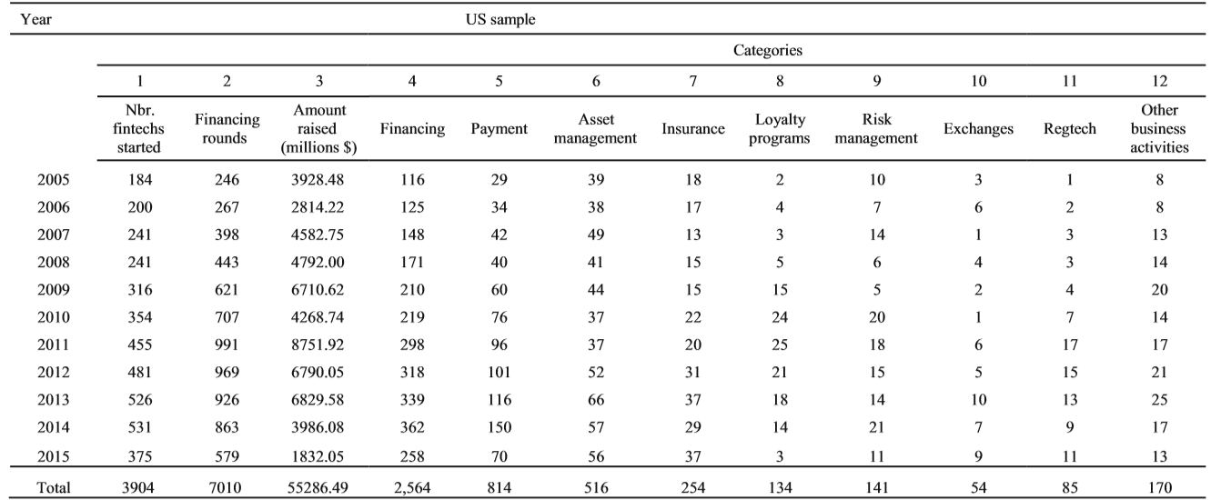
Summary Statistics

Slide 15
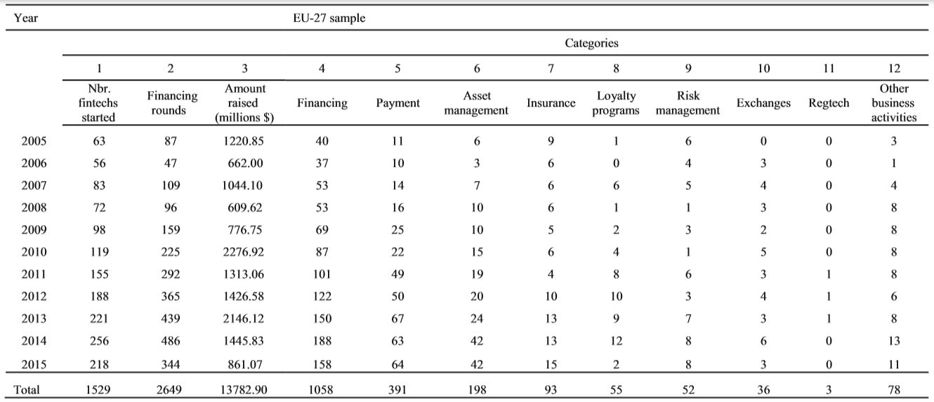
Summary Statistics

Slide 16
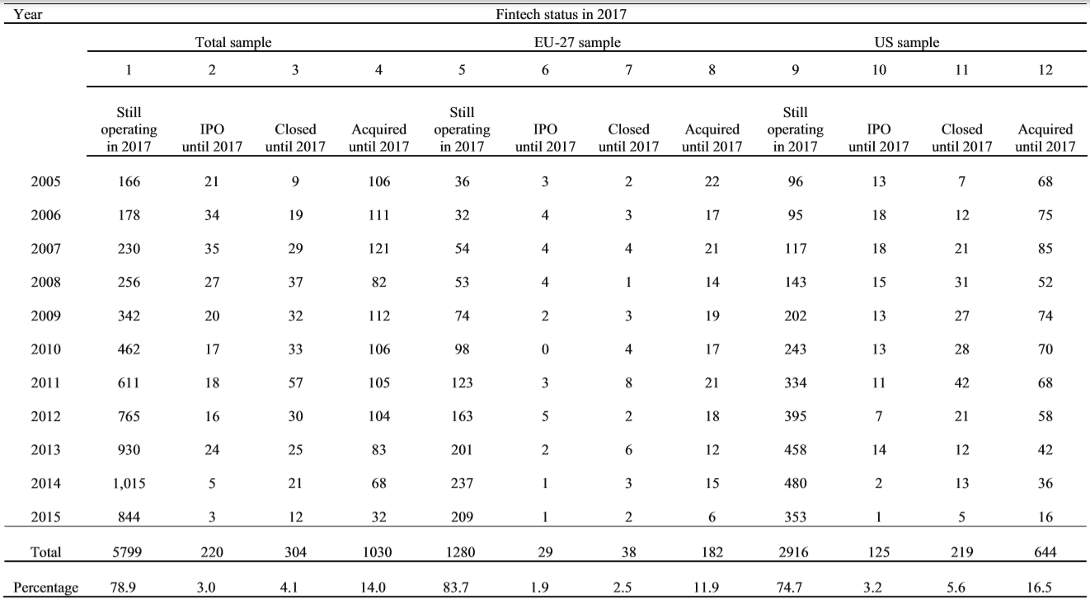
Summary Statistics

Slide 17
Empirical results
We estimate the following RENB model:
Pr(y_{i1}, y_{i2}, ..., y_{iT}) = F(GDP per capita _{i,t-1} + commercial bank branches _{i,t-1} + VC financing _{i,t-1} +MSCI returns _{i,t-1} + latest technology _{i,t-1} + mobile telephone subscriptions _{i,t-1} + internet penetration _{i,t-1} + secure internet servers_{i,t-1} + fixed broadband subscriptions_{i,t-1} + soundness of banks _{i,t-1} + ease of access to loans _{i,t-1} + investment profile _{i,t-1} + MSCI crisis period _{i,t} + labor force _{i,t-1} + regulation _{i,t-1} + unemployment rate _{i,t-1} + new startup formation _{i,t-1} + law and order _{i,t-1} + freedom to trade _{i,t-1} + sound money _{i,t-1} + strength of legal rights _{i,t-1} + cluster development _{i,t-1})

Slide 18
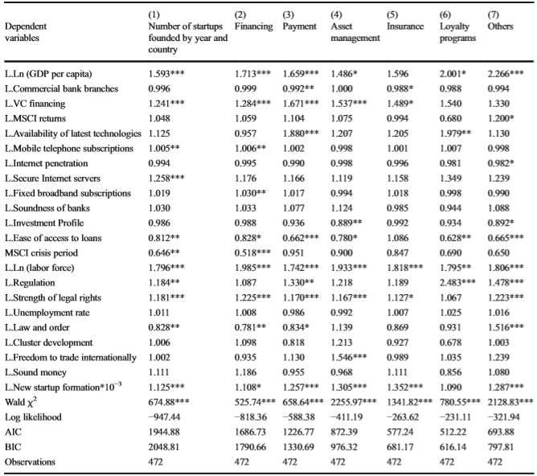
Empirical results

Slide 19
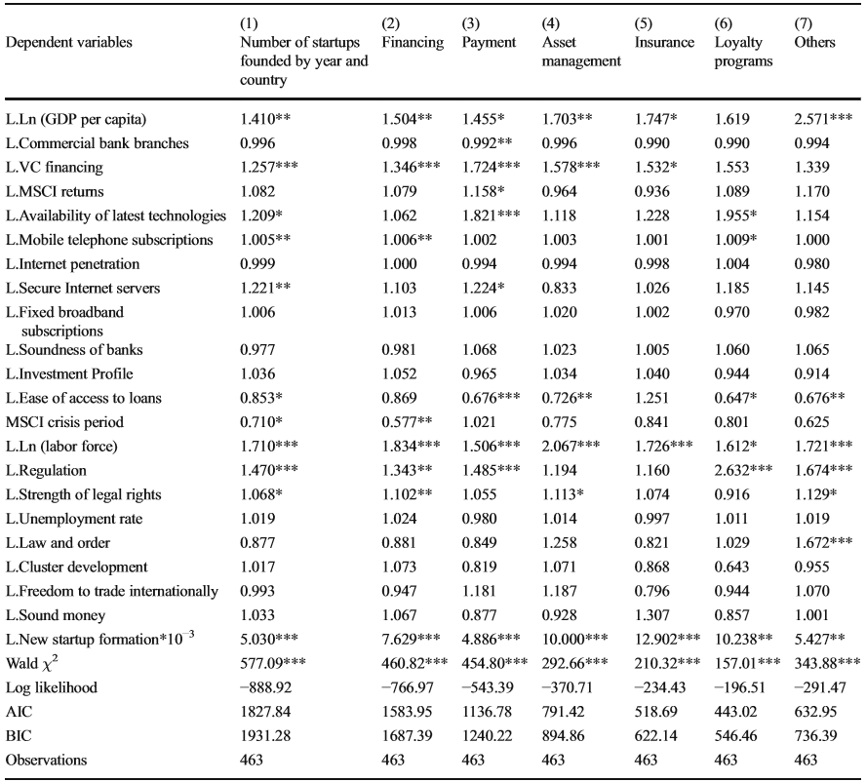
Empirical results

Slide 20
Policy implications
Implications for regulators
Providing affordable and sustainable technology as well as the supporting infrastructure
Developing and promoting financing services provided by fintechs through regulatory sandboxes and other policy measures
The question of systemic risk caused by fintech services need to be taken more carefully in future studies
Implications for incumbent financial organizations
Attracting a criticial mass of highly specialized individuals is critical to establish a new hub or ecosystem.
Well-functionning and easily understandable immigation laws
The possibility to easily transfer pension claims
Affordable housing

Slide 21
Policy implications
Implications for fintech entrepreneurs
Keeping Fintech innovative unique ideas away from banks and large established firms
Cooperation with banks might make sense in some cases
Monitoring upcoming changes in the regulatory environment
Implications for investors in fintechs
Promoting the development of venture capital financing
Opportunities for investors are available in both developed and developing countries
Caution is needed when investing in some sectors of fintechs like equity crowdfunfing

Slide 22
conclusion
Explored the global fintech market
USA had the largest fintech market until 2015
Financing is the most important segment of the emerging market
Empirical findings
Countries witness more fintech startup formations when :
The economy is well developed and venture capital is available
The economy has secured internet severs, more mobile telephone subscriptions and available labor force
The economy suffered more from the financial crisis and credit loans are unavailable

Slide 23
Thank you!
Contact information:
Christian.haddad@edhec.edu

